Slide 1
PAH156 - PDP Information Hierarchy - Mobile
Test Plan

Slide 2
Overview
1
Rationale & Hypothesis

Slide 3
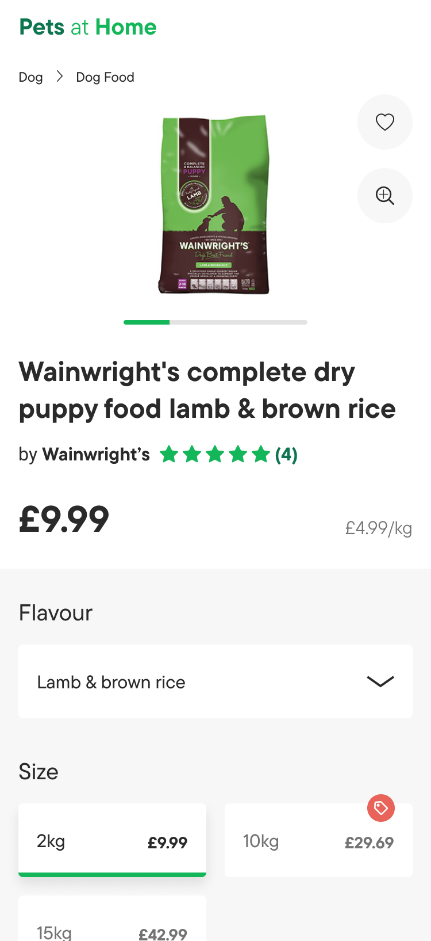
Rationale
Why are we running this test?
This test aims to validate the proposed Polestar mobile PDP designs, specifically the hierarchy of the above-the-fold information.
The proposed Polestar designs prioritise, in order, the products:
Image(s)
Title
Brand
Review star rating – if applicable
Price discount information (e.g. 10% off) – if applicable
Current price
Was price – if applicable
Normalised price (e.g. £10/kg) – if applicable
Testing this approach to the information hierarchy will give us insight into the most intuitive way for this information to be presented to the user.

Slide 4
Variations
2
Designs & Summary of Changes

Slide 5
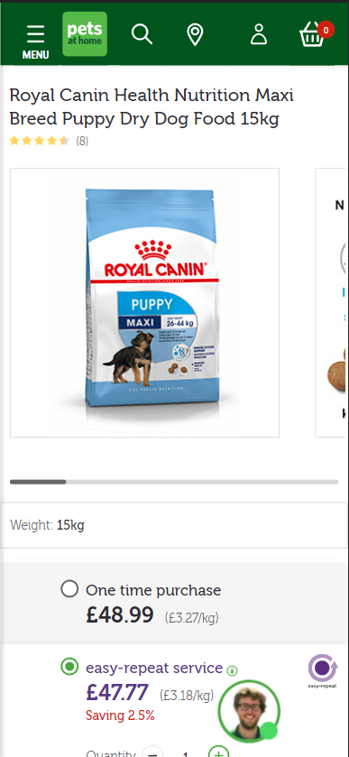
Control
What is the current experience?
The current PDP design follows the below hierarchy
Product title
Product review star rating
Product image(s)
Product Weight/Size
Product Purchase Options

Slide 6
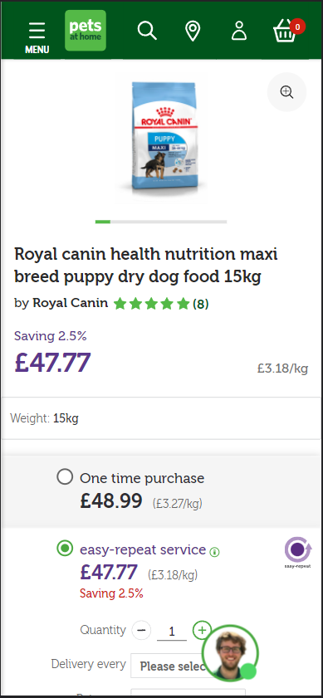
Variation 1
What are we changing?
This variation makes several key changes to the design and hierarchy along with introducing additional functionality.
The hierarchy has been adjusted to the following order
Product image(s)
Product title
Product brand & review star rating
Product price information
Product weight/size
Product purchase options
This variation also refreshes the design of the first 4 elements in-line with the proposed Polestar designs.
In addition to the design and hierarchy changes, this variation also introduces a zoom feature to the product image(s)

Slide 7
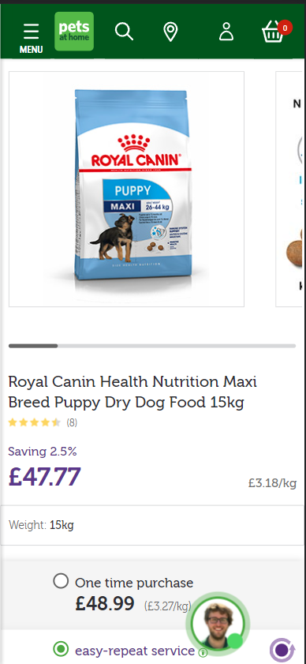
Variation 2
What are we changing?
As with Variation 1, the hierarchy has been adjusted to the following order:
Product image(s)
Product title
Product brand & review star rating
Product price information
Product weight/size
Product purchase options
However, this variation does not feature the changes to the elements’ design or the addition of the zoom feature.

Slide 8
Test Configuration
3
Targeting, Timeline, & Tracking

Slide 9
Configuration
Key Metrics & Segments
Where will the test run?
Across all Product Details Pages.
What browsers/devices will the test run on?
The test will run across all mobile devices and browsers.
How long will the test be live?
Based on data obtained from Google Analytics for Feb 2022, we expect the test to run for approx. 1 week, depending on levels of traffic.
Key Metrics
The primary KPI that we will base the test’s success on is Add to Basket Rate.
For our secondary KPIs, we will measure the subsequent progression through the funnel to support our analysis of each variation.
We will also measure engagement with the product images, reviews & bounce rate, as well as focus on Easy Repeat & Click & Collect purchases to augment our understanding of the impact of each variation.
Key Segments
New & Returning Users
Paid Traffic Users (Google Shopping, Paid Social, & PPC Traffic)
Users that land on a PDP (the first page visited)

Slide 10
Tracking
4
Segment, Dimension, & Metric Definitions

Slide 11
E-commerce Segment-Based Metrics
E-commerce Built-in Metrics
Add to Basket
Dimension: Shopping Stage
Value equals: ADD_TO_CART
Basket Progression
Dimension: Page Path
Value contains one of the following:
/shop/basket
/webapp/wcs/stores/servlet/checkoutbasket
Checkout Step 2 Progression
Event Category = Ecommerce
Event Action = Checkout Step
Event Label = 2
Checkout Step 3 Progression
Event Category = Ecommerce
Event Action = Checkout Step
Event Label = 3
Transactions
E-commerce Conversion Rate
Revenue
Avg. Order Value
Order Delivery Type
Order Type

Slide 12
Engagement Segment-Based Metrics
Engagement Built-in Metrics
Variant Impression
Custom Dimension: 22 (Optimisation Slot #1)
Value is one of the following:
pah156: Control
pah156: Variation 1
pah156: Variation 2
Gallery Image Impression
Event Category = CRO Test Event
Event Action = Gallery Image Engagement
Gallery Zoom Open
Event Category = CRO Test Event
Event Action = Gallery Zoom Open
Gallery Zoom Close
Event Category = CRO Test Event
Event Action = Gallery Zoom Close
Reviews Star Engagement
Event Category = CRO Test Event
Event Action = Reviews Star Engagement
Bounces
Bounce Rate
Heatmaps
PAH156: Control
PAH156: Variation 1
PAH156: Variation 2

Slide 13
Conclusion
5
Please direct any questions to the Pets at Home Optimisation team.

